Slide 1
Ethically
BY ETHICAL PATHS

Slide 2
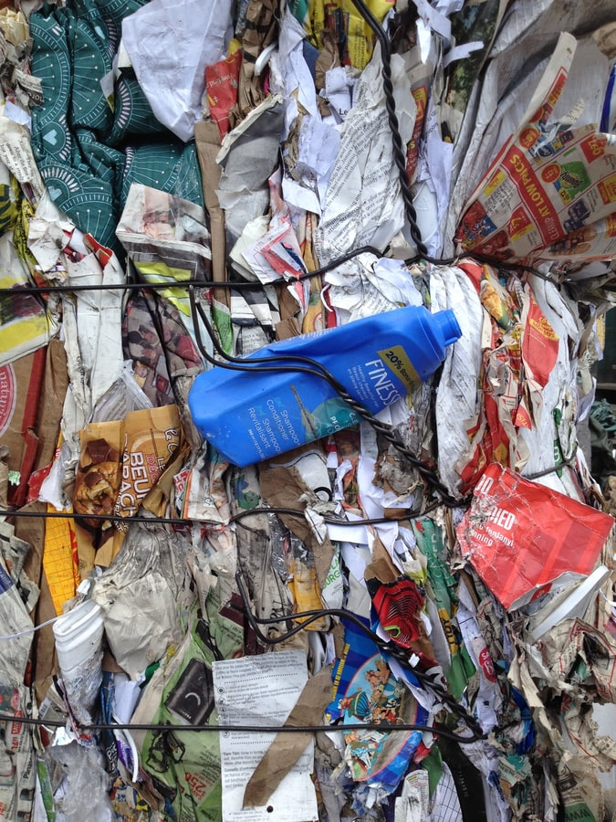
WHAT IS GOING ON
Reduced cooperation of citizens and management structures
Lack of environmental education
Digital illiteracy

Slide 3
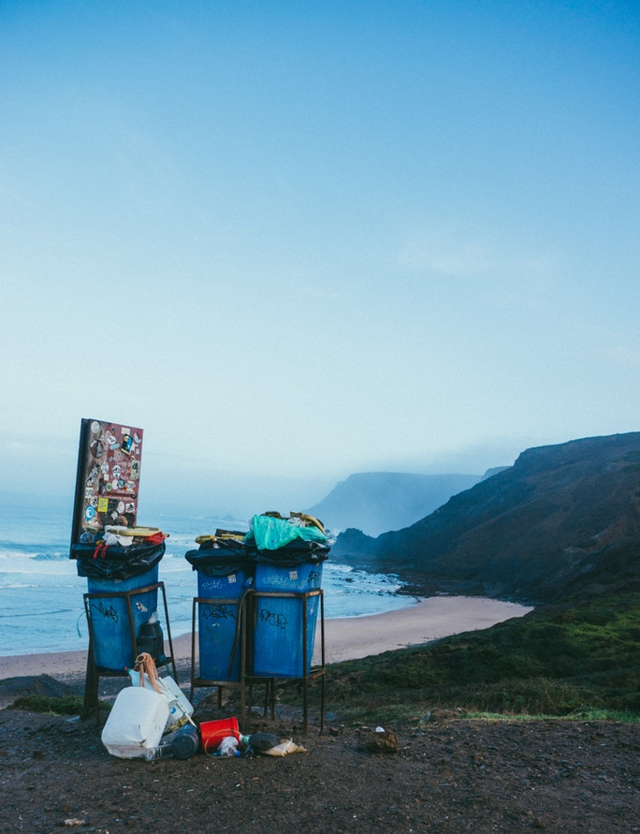
DIFFERENTIATOR
Introducing zero waste techniques
Support of civic engagement
Age index increase

Slide 4
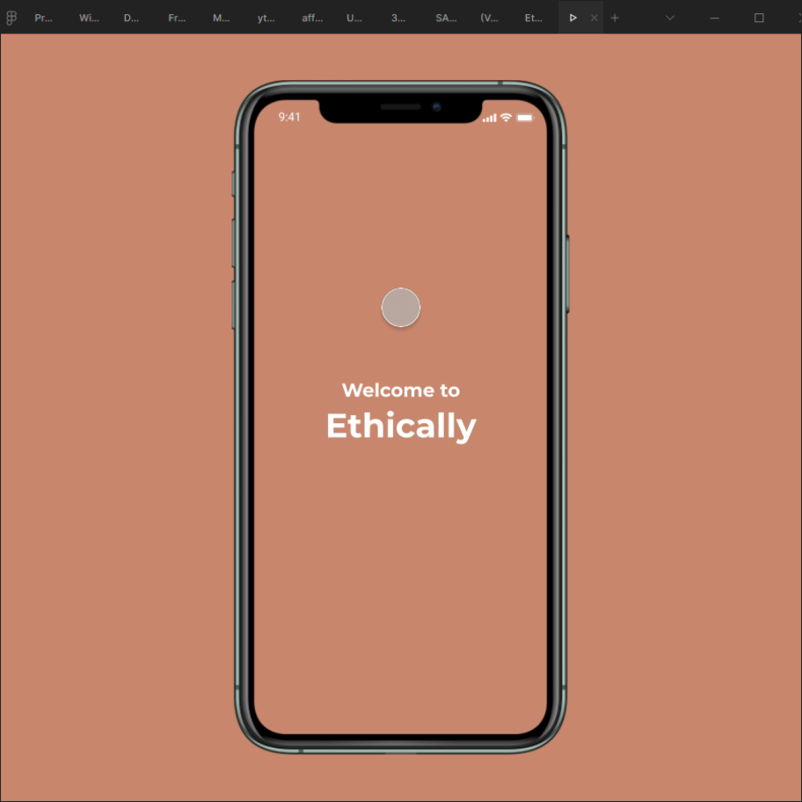
WHAT WE OFFER
Accessibility tools for each target group
Interactive challenge for tracking waste
Maps locating proposed stores with sustainable products
Maps mentioning recycling spots

Slide 5
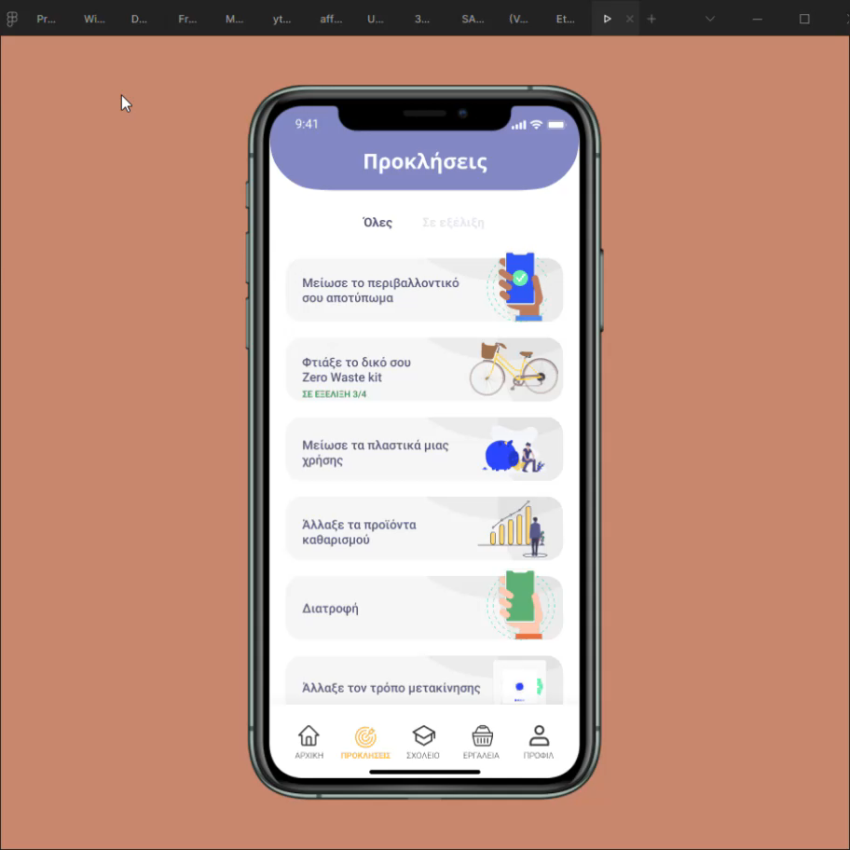
WHAT WE OFFER
Guidance for better recycling
Zero waste swaps and proposals
Activities for students
Communication platform for educational assistance

Slide 6
RESEARCH SO FAR
WHAT DO YOU WANT TO SEE
ΔΑΝΙΑ

Slide 7
WHY WE CHOSE SUP FREE HACKATHON
GOVERNMENTAL
SUPPORT
COVID-19 EXPERIENCE WITH DISTANCE LEARNING
IDEAL KNOWLEDGABLE
COMITTEE

Slide 8
COMPETITION
MARKET
NGOs for Environmental Education
Tools for reducing waste
Applications for zero waste
83.706
60.385
educators
10.130
3.168
schools
4.350.444
populations

Slide 9

IMPLEMENTATION
Greek Ministry of Education and Religious Affairs
Foundations active in the field of Environmental Awareness
For-profit entities interested in the field of Corporate Social Responsibility
Notes:
ΔΙΑΦΟΡΕΣ ΣΕ ΤΟΠΙΚΟ ΕΠΙΠΕΔΟ, ΛΙΓΟΤΕΡΟ ΠΡΟΝΟΜΙΟΥΧΟΙ

Slide 10
MARIA ARTEMISIA NIKOLAIDOU
MICHAEL KARABERIS
ALEX
TSISTRAKIS
KOSTAS
SOLEIDIS
MEET THE TEAM

